Slide 1
ENSE 496ab, Milestone 3
!Cool
Team Members:
Christian John
Ahmed Shamiss
Jeremy Cross
Evan Geissler
Taylen Jones
Dakota Fisher
25th October, 2018

Slide 2
Team !Cool
We are team !Cool and and our group members are:
Christian John
Ahmed Shamiss
Jeremy Cross
Evan Geissler
Taylen Jones
Dakota Fisher
We are assigned to the Weekend Warriors project

Slide 3
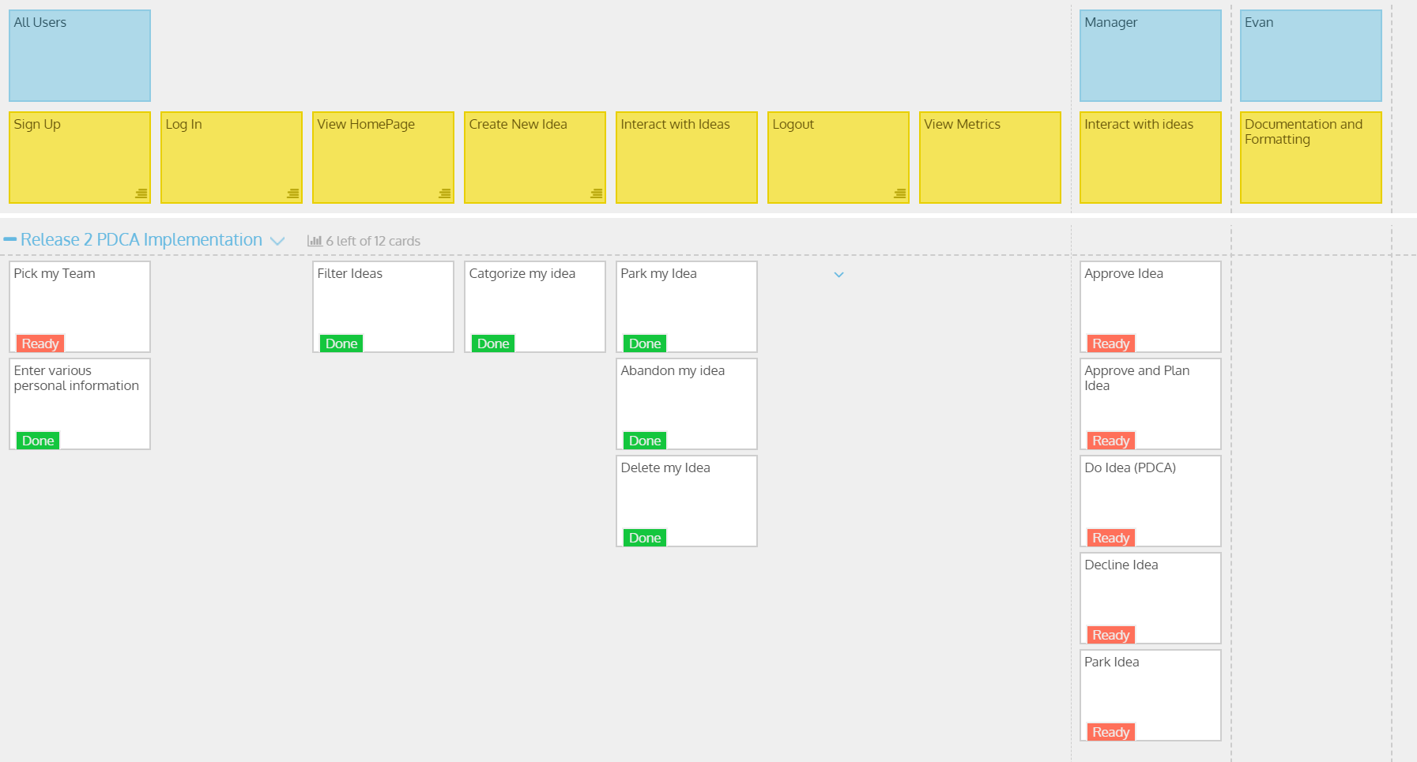
Updated USM

Slide 4
DEMO TIME !!!

Slide 5
Comments/Discussion
Successes
Becoming more familiar with ASP.net
Idea Search and Filter
Barriers to success?
Identity roles
image upload
Other
Better to make training documents that are consistent to eHealth’s

Slide 6
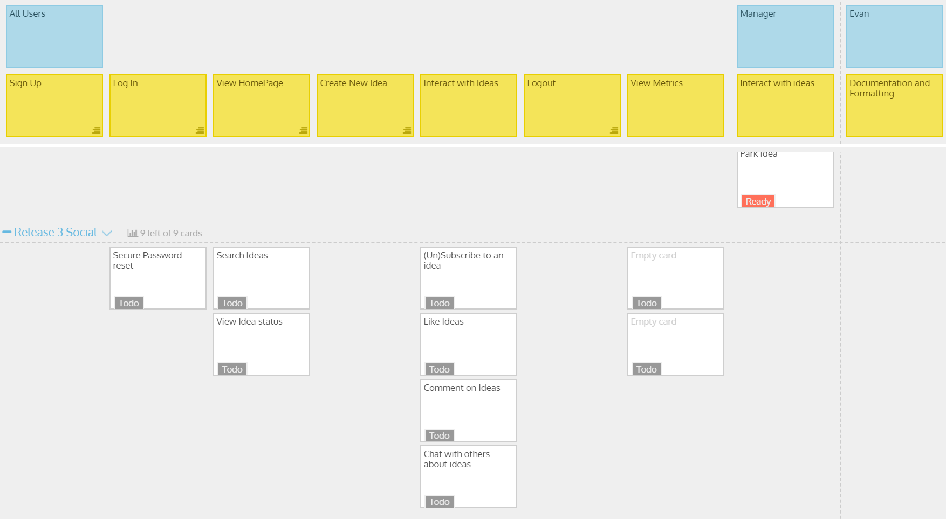
Sprint 3 Deliverables

Slide 7
Group reflection
How did you feel about this milestone? What did you like about it? What did you dislike?
Milestone was successful
Liked how our idea cards came out
Dislike Identity Roles
What did you learn about yourself as you collaborated and worked through this milestone?
Collaboration is nice, being able to ask others for help with things who are more knowledgeable

Slide 8
Group reflection
How will you use what you have learned going forward?
We take the work that we have accomplished with this milestone and progress with milestone 4
What “stuff & things” related to this milestone would you want help with?
I Think for the most part we were fine

Slide 9
Questions?

